Slide 1



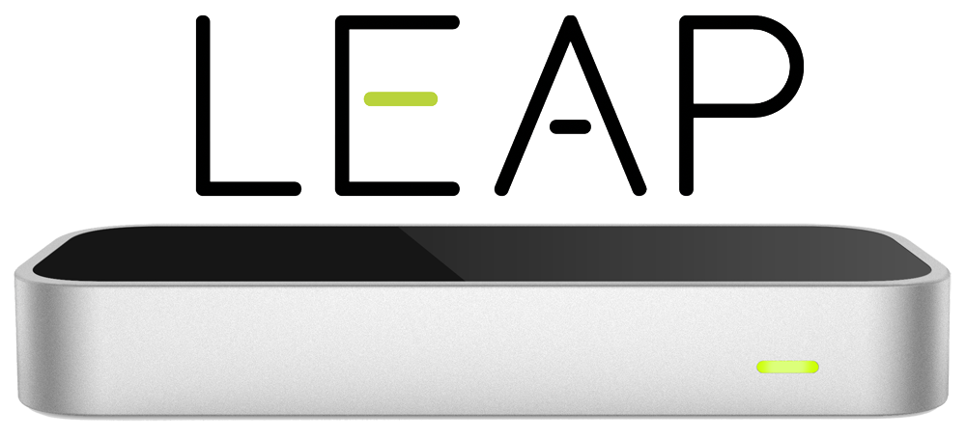
V&V Presentation
Students: Matt Raporte, Greg Potter
Customer: Professor Huang

Slide 2
From our V&V doc:
Scope of software
Typical use case
The software is expected to have the following components:
A Detection component to listen for user hand gestures and identify them
A Translation component communicates the detected gesture to the action component
An Action component takes the gesture name and performs the correct action to the power
The user runs our program and launches a PowerPoint presentation. The user issues physical hand gestures over the Leap Motion sensor, which are detected and identified in live time by our Detection component. Each detected gesture is put on a queue and then our application send commands to PowerPoint.

Slide 3
Detection Component

Slide 4
Progress:
-Finalized an architecture for detecting gestures efficiently
selective frame retention, fewer API object calls, “in progress” and risk gestures tested first
-Switched from Listener.onFrame() frame recognition to custom spinner implementation
Avoids frame call-back multithreading issues (by only storing relevant info, at relevant time periods)
Much faster
-Implemented “stretch” goal working custom gestures
Issues: 2 hand detection latency, API object interface
Still testing and improving these
-Created tools for gesture development:
gesture to excel mapper, gesture stage time tester

Slide 5
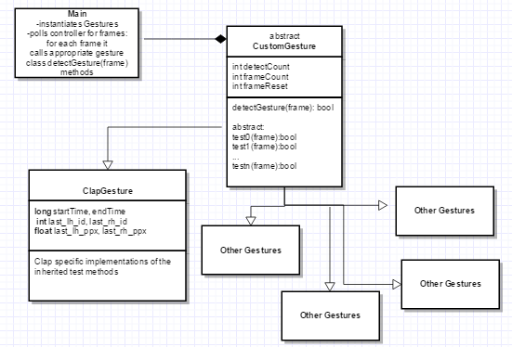
Gesture architecture quick overview:

Slide 6
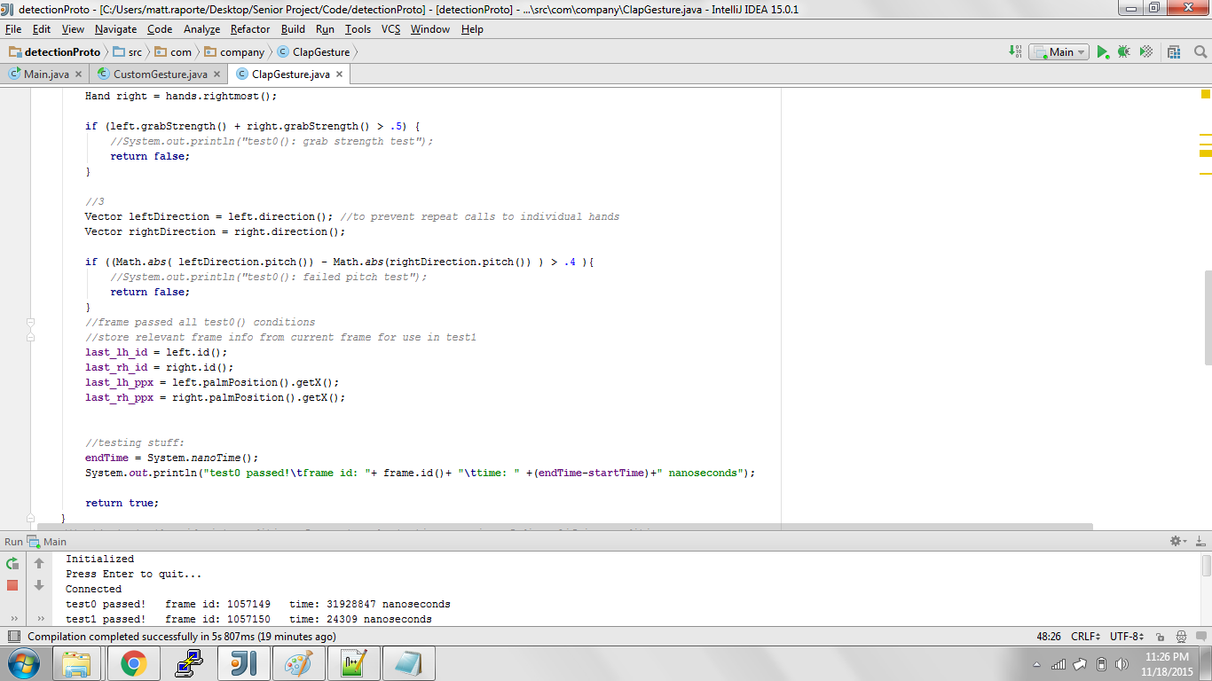
Gesture testing:
test method condition checks
store frame-persistent data
stop timer, print dev data to console
frame id’s help track how many frames have passed since previous test (run at ~40-110fps)
what it looks like

Slide 7
Gesture testing
-Current method of testing speed allows us to determine execution times of each gesture’s individual test methods. In both detection and non-detection scenarios.
This helps identify problem areas such as expensive API object calls or inefficient code very quickly (ie storing palm positions of previous frames and comparing them current positions to calculate velocity instead of using the API palmVelocity() which creates new threads to access past frame data)
Also helps identify logical order of gestures to test for in each frame (fast ones first or common ones first?)
-Gesture component will eventually be “officially” tested for accuracy+speed by having testers issue a random list of all the gestures, with detection speeds being recorded by the process and detection rate recorded manually (by monitoring console outprints)
-Goal is > 90% detection and <1.5s latency for each gesture
•We’re currently exceeding the latency goal, but struggling with the accuracy goal (hardware?)

Slide 8
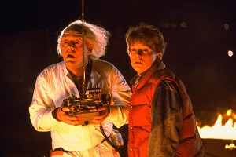
What’s next?
Implement API Gestures (base level) using CustomGesture architecture (why?)
Continue using gesture-excel-mapper and gesture-test-timer to continue improving gesture accuracy and speed
Conduct “official” testing, and make pretty diagrams or whatever for the final poster

Slide 9
Translation Component

Slide 10
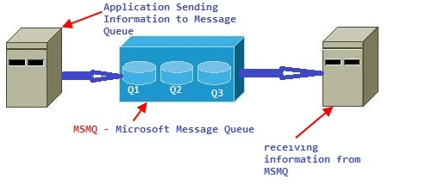
Translation
Using MsmqJava library to connect to the queue
Check to make sure that commands were in the last 4 seconds, otherwise throw them away

Slide 11
Action Component

Slide 12
Action
Runs as a standalone process from the rest:
Theoretically we could mock out the PowerPoint application but we don’t think that’s necessary
Working slide control!
Adding in the media/link interactions now.
Planning on adding visual feedback on the latest command

Slide 13

Full Scope Testing
2 different tests:
latency + accuracy testing of synced up components to determine %accuracy and average execution speeds for each gesture-action pair.
time will start at the beginning of each gestures test0() and end after PP action is executed. Accuracy will have to be recorded manually
Succeeds if each gesture’s latency is <2s and detection is >85%
live test by using our software to give a presentation, hopefully by the in class practice final presentations 11/24 and 12/01.
Succeeds if we’re able to demonstrate each gesture successfully, and are able to give the entire presentation without aid from other input devices

Slide 14
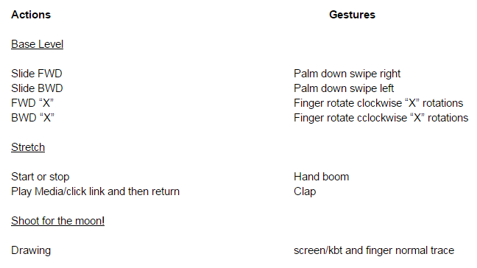
Finally..
We’ve been having to adjust our technical requirements due to technical limitations, but we now have a finalized list of gesture-action pairs:

Slide 15
Any questions?

